Slide 1

MUSIC PLAYLIST MANAGER
BY : (GROUP-7)
AMATULLAH SAJIDA
SHAIKH ADIBA NUR
NOUSHIN TABASSUM
SUDIPTO SARKAR

Slide 2
PROJECT OUTLINE
INTRODUCTION 1-3
REPRESENTATION OF CODES 4-6
OUTPUTS 7-15

Slide 3
INTRODUCTION
The Music Playlist Manager is a Java-based application designed to simplify the way users organize and enjoy their music collections. With features such as creating playlists, adding songs, and seamless music playback, it offers a convenient and efficient solution for managing personal music libraries.

Slide 4
The application utilizes -
Java Swing- for a user-friendly graphical interface
Multithreading- for smooth playback, and
File input/output- for saving playlists

Slide 5
Developed as a university project, it showcases the practical
application of programming concepts and provides users with
an engaging and functional tool to enhance their music experience.

Slide 6
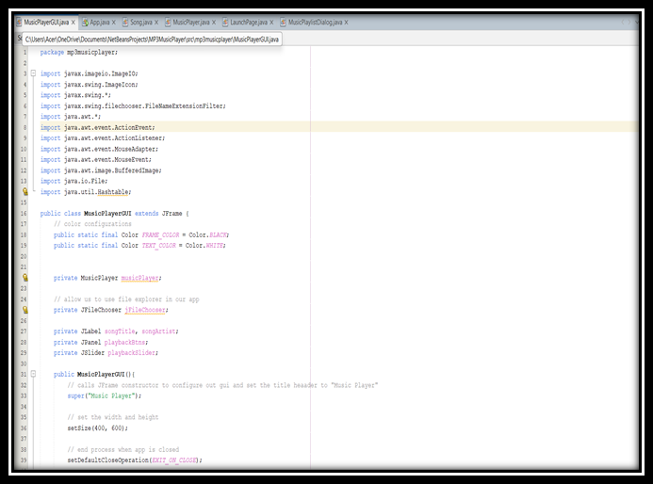
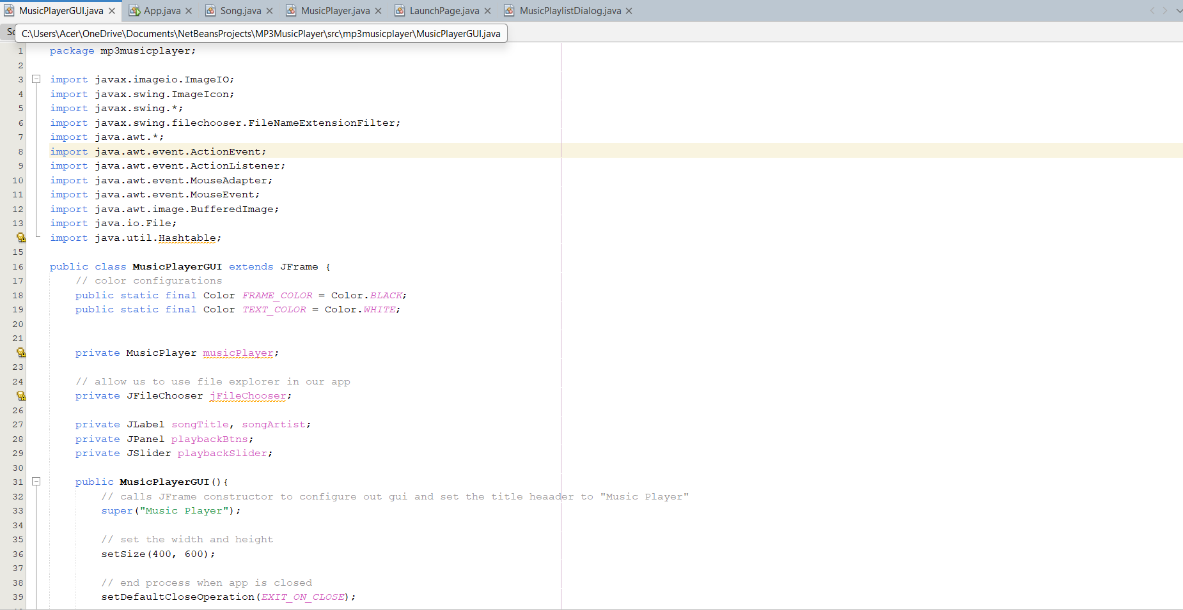
CODE IMPLEMENTATION
MusicPlayer Class
MusicPlayerGUI Class
Controls the playback of music, providing methods to play, pause, skip, and navigate
through songs.
Implements multithreading to separate the playback functionality from the main GUI,
ensuring a smooth user experience.
Fully implemented and integrated with other classes.
Provides the main graphical interface where users can interact with the application.
Includes buttons for controlling playback, a display area for song metadata, and a progress slider for the current song’s position.
Fully implemented and integrates with the MusicPlayer class to provide a seamless user interface.

Slide 7
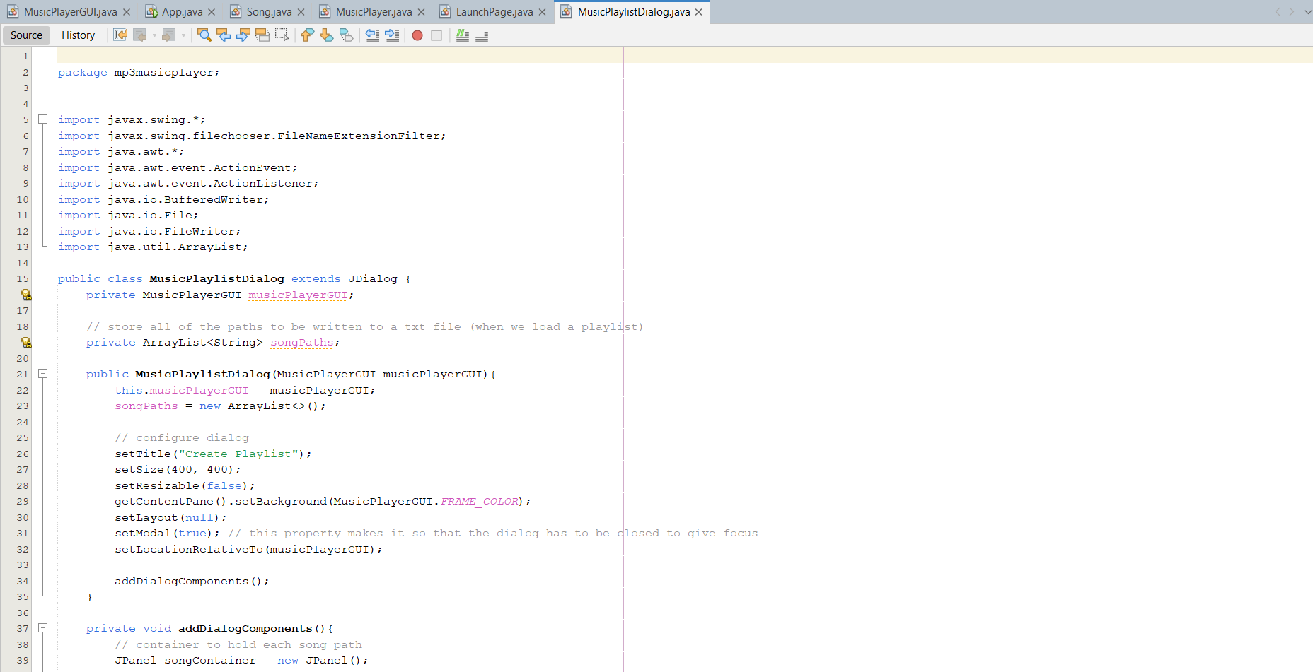
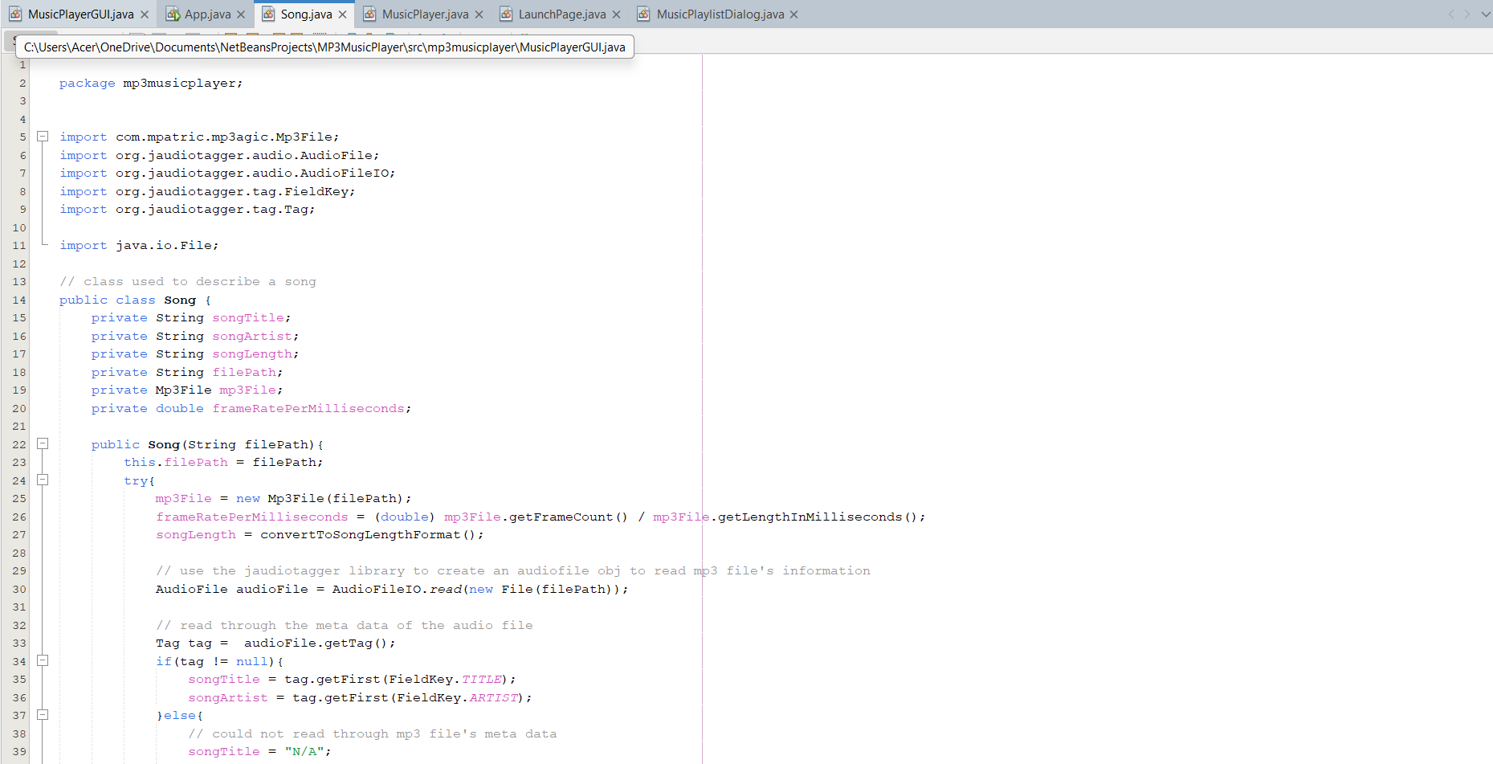
CODE IMPLEMENTATION
MUSIC PLAYLIST DIALOG CLASS
SONG CLASS
Allows users to create, edit, and manage playlists.
Users can add or remove songs from playlists, and save/load playlists to/from files.
Fully implemented, ensuring users can manage their music collections efficiently.
Represents a single song in the system, holding attributes like title, artist, and file path.
Uses external libraries (mp3agic and jaudiotagger) to read and write metadata from audio files.
Fully functional and tested.

Slide 8
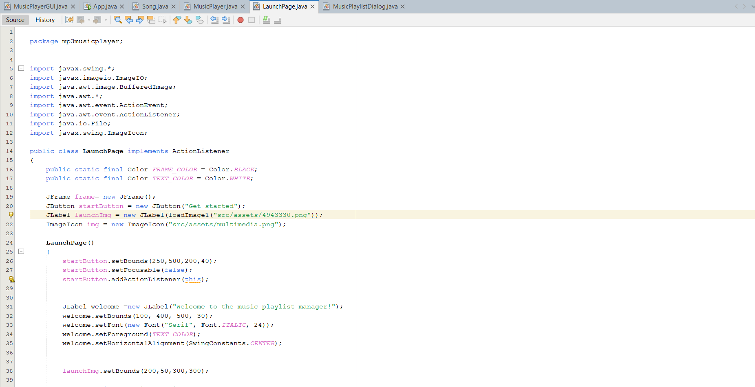
CODE IMPLEMENTATION
LAUNCHPAGE CLASS
The entry point to the application, featuring a welcome screen with the application logo and a button to transition to the main interface.
Fully implemented and integrated into the application workflow.

Slide 9
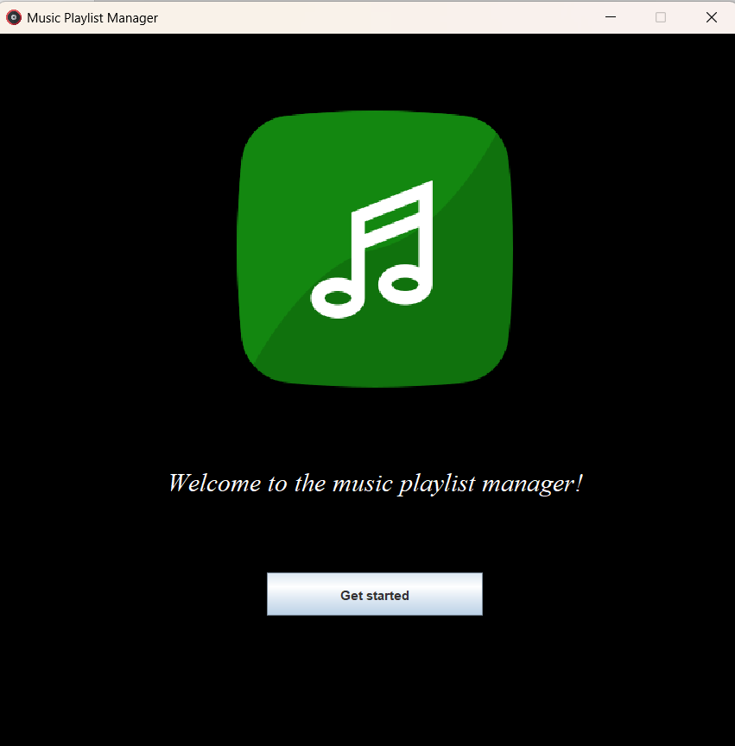
INITIAL WINDOW

Slide 10
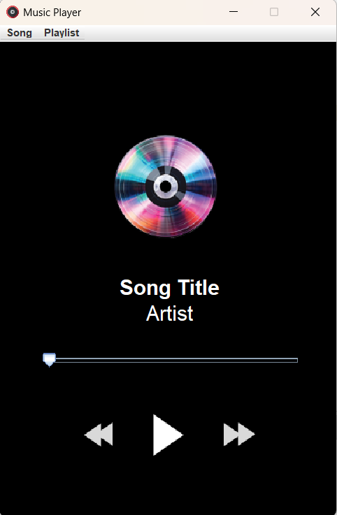
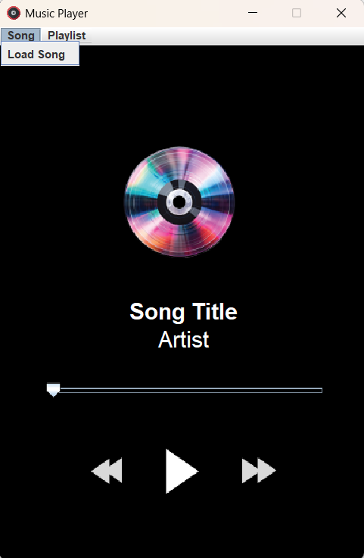
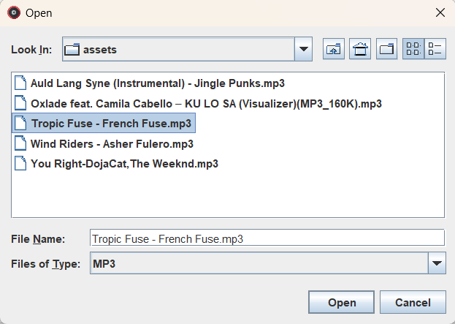
LOAD SONG

Slide 11
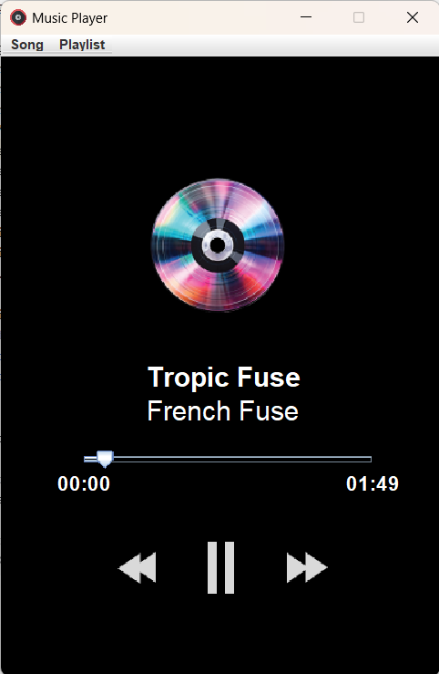
SONG PLAYED AFTER LOADING

Slide 12
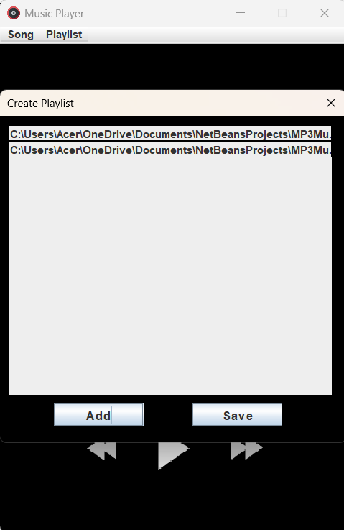
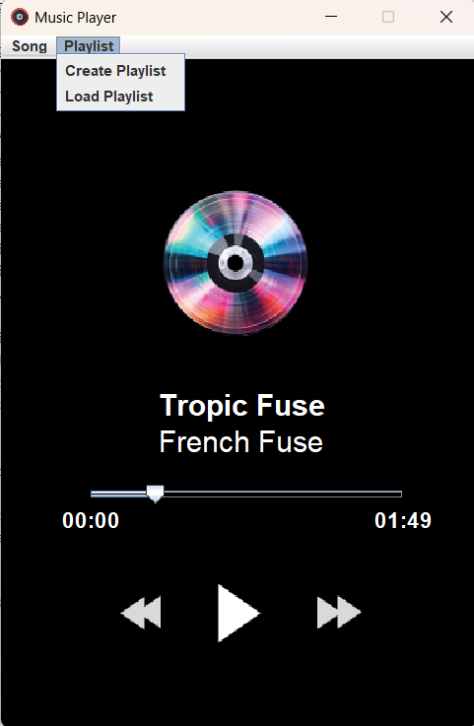
CREATING PLAYLIST

Slide 13
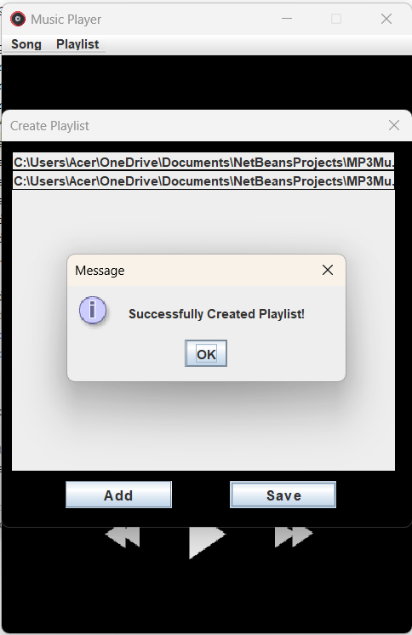
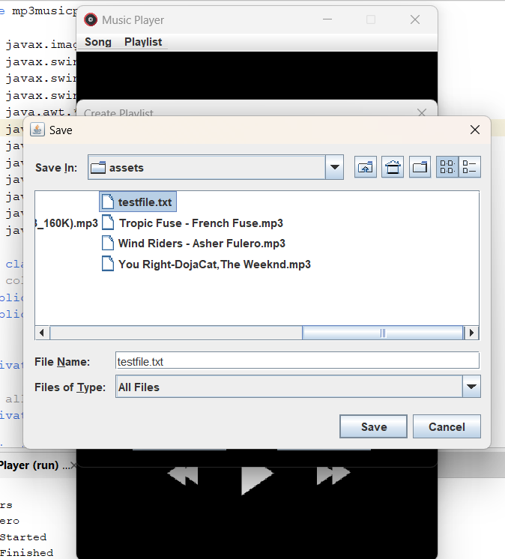
CREATING PLAYLIST

Slide 14
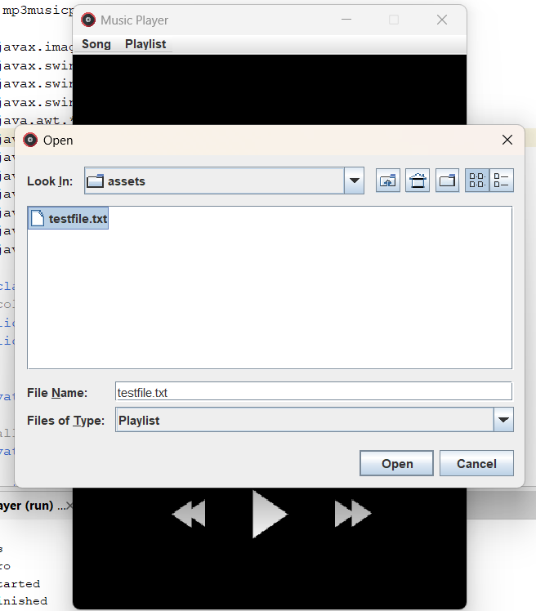
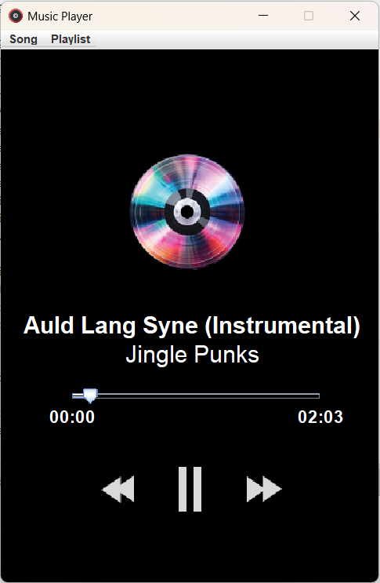
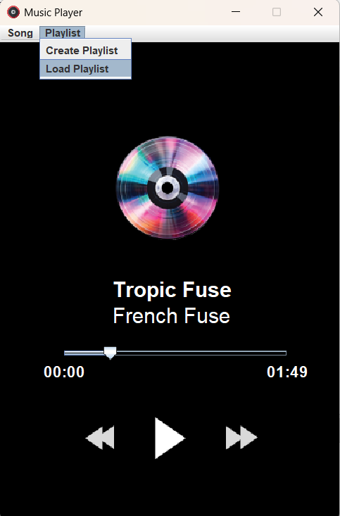
LOAD PLAYLIST

Slide 15
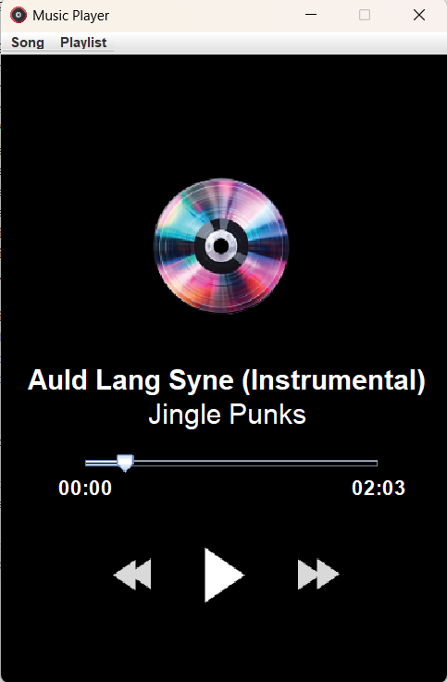
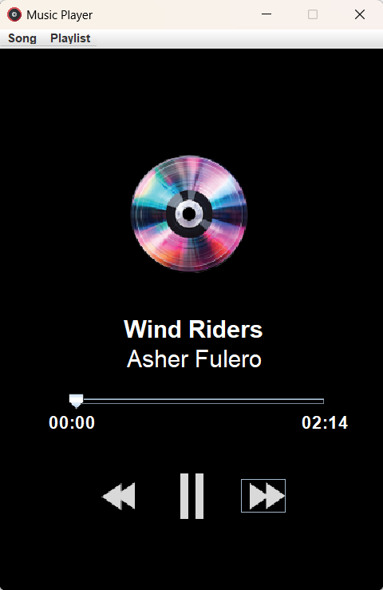
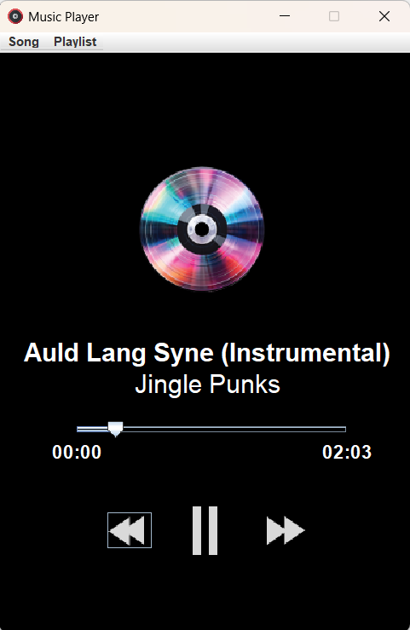
PLAYBACK CONTROL
Pause Button
Forward Button (Next Song)
Backward Button (Previous Song)

Slide 16
Thank You!😊

